Slide 1

Time series Stock Market analysis and prediction project
Time Series
Stock Analysis
Predicting with Linear Regression
Prediction with Neural Network (LSTM)
Quantopia – Mean Reversion Algorithm – Back Testing

Slide 2
Time series
Time Series Analysis
Analyzing time series data in order to extract meaningful statistics and other characteristics of the data.
Time Series Forecasting
Estimating many future aspects of a business or other operation based on the current time series

Slide 3
Importance of Time series
A very popular tool for Business Forecasting
Basis for understanding past behavior
Can forecast future activities/planning for future operations
Evaluate current accomplishments of performance
Facilitates comparison

Slide 4
Time series analysis
Applications
Economic Forecasting
Sales Forecasting
Budgetary Analysis
Stock Market Analysis
Process and Quality Control
Inventory Studies
Workload Projections
Utility Studies

Slide 5







Time series in Stocks data (Equities)

Slide 6
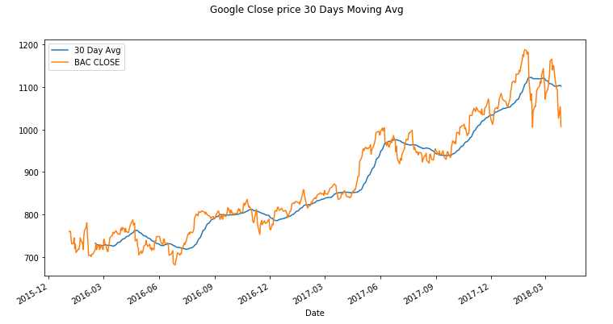
Time series analysis - 30Days Moving average

Slide 7
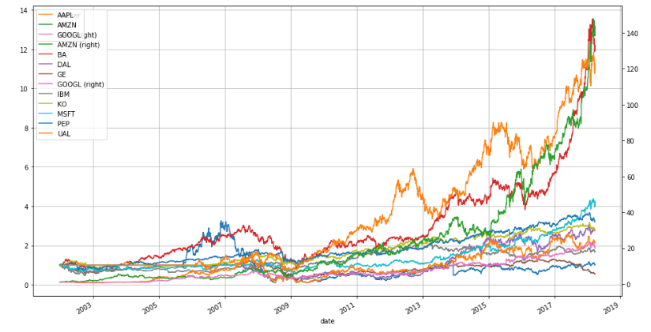
Time series analysis - Calculating simple daily cumulative returns – series of equities
Notes:
Calculating simple daily percentage change
Calculating simple daily cumulative returns
Analyzing the distribution of returns

Slide 8
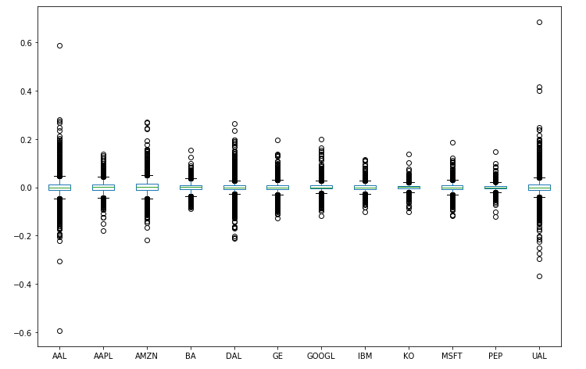
Box plot – stock comparison
This plot gives us a very good comparison of the performance of these stocks over this period of time.
The wider the box, the higher the variability and the risk.
Notes:
Calculating simple daily percentage change
Calculating simple daily cumulative returns
Analyzing the distribution of returns

Slide 9
Time series analysis – expanded examples
Analysis Methods
Percent Change – Daily, Weekly, Quarterly, Yearly
Weighted Averaging Method
Exponential smoothing Method

Slide 10
Linear Regression Stock Prices - Google forecasting
Data
Preprocessing
Data
Split Data
Test
Forecast
Create a Forecast
Scaling the data to eliminate sparsity
Train
Accuracy Level
97.86%

Slide 11
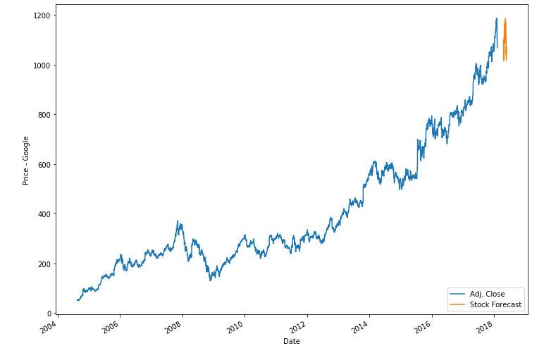
forecasting plot Google
Notes:
Because Google is on an uptrend, basically the trend would be on the up.

Slide 12
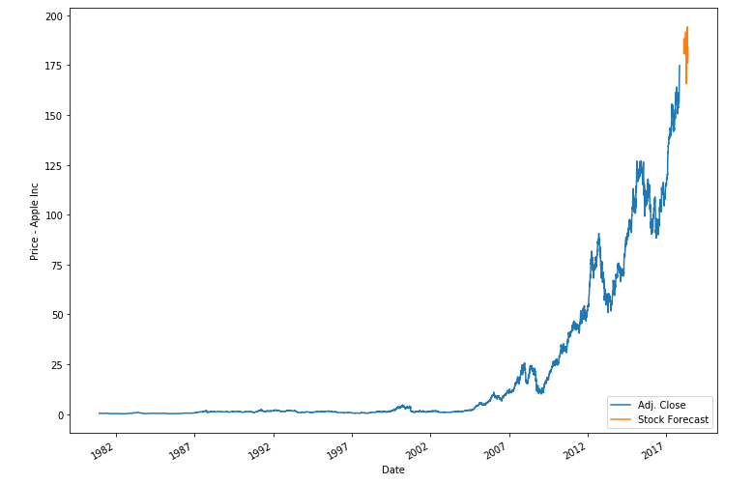
Stock prediction – apple inc
Apple Prediction Accuracy: 97.55%

Slide 13
Stock prediction - Lstm
Deep Learning
Long Short Term Memory (LSTM)
Very powerful in sequence prediction problems because they’re able to store past information. This is important in our case because the previous price of a stock is crucial in predicting its future price

Slide 14
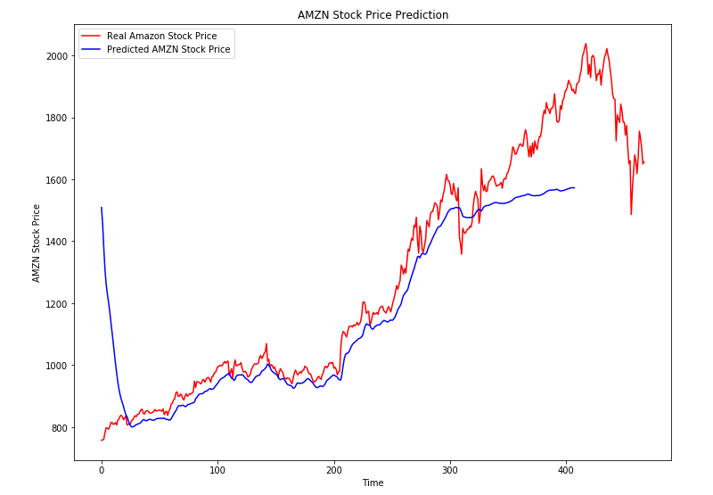
Lstm prediction - amazon
Variables
Full Data
1500 Data Points
900 Data Points
100 Data Points
50 Neurons
100 Neurons
500 Neurons
1000 Neurons
More Neuron Does not give a better predictions, Reduced Train/Test Data still gives the same prediction but faster

Slide 15
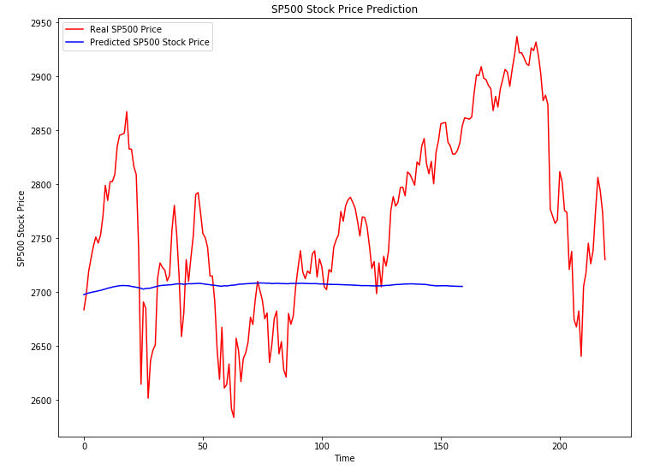
Lstm prediction – SP500
LSTM has not been a good predictor, not a straight forward process
Requires further adjustments to the model for better Accuracy
WTF

Slide 16
Back to basic - 30Days Moving avg
Would a 30 Days Moving Ave Enough to predict a Trend?
Or Add as our Feature

Slide 17
Quantopia - mean-reversion algorithm
Methodology
Uses a Dynamic stock selector pipeline
Selection
Orders stocks from the top 1% of the previous day’s Dollar-volume (liquid stocks)
Theory
Top-performing stocks from last week will do worse this week, and vice-versa
Trade
Every Monday, we rank high dollar-volume stocks based on their previous 5 day returns
We long the bottom 10% of stocks with the WORST returns over the past 5 days
We short the top 10% of stocks with the BEST returns over the past 5 days

Slide 18
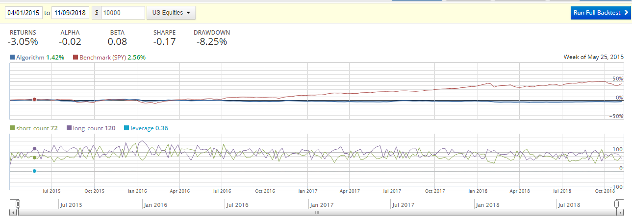
mean-reversion algorithm – back testing results
Testing Period Apr 2015 – 9 Nov 2018
Final results Algo fails to exceed return from Benchmark SPY
SPY
Algo

Slide 19
Final thought
TEST Model
Improve your Model
Analysis
Deploy
End of Chapter

